Slide 1
Command Pattern
Wali Muhammad (2021-SE-39)

Slide 2
Agenda
Introduction
Usage & Implementation
Examples
Applicability
UML Diagrams
Consequences

Slide 3
Introduction
Behavioral Design Pattern
Encapsulate a request as an object, thereby letting you parameterize clients with different requests, queue or log requests, and support undoable operations.

Slide 4
Usage
Issue requests to objects without knowing anything about the operation being requested.
Menus can be implemented easily with Command objects.
When you have to run a sequence of commands.

Slide 5
Examples
Remote Controlling System
Software's (e.g. Versioning Control Tool, Text Editor)
Games

Slide 6
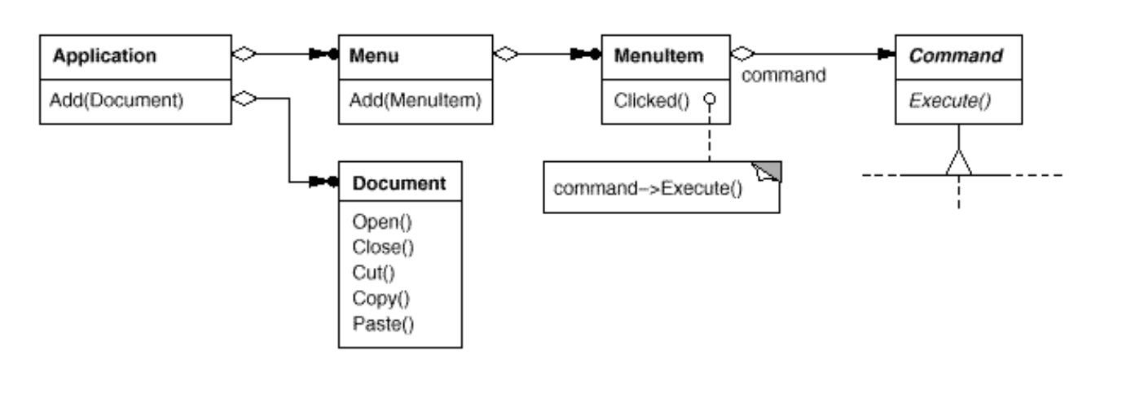
UML Diagram

Slide 7
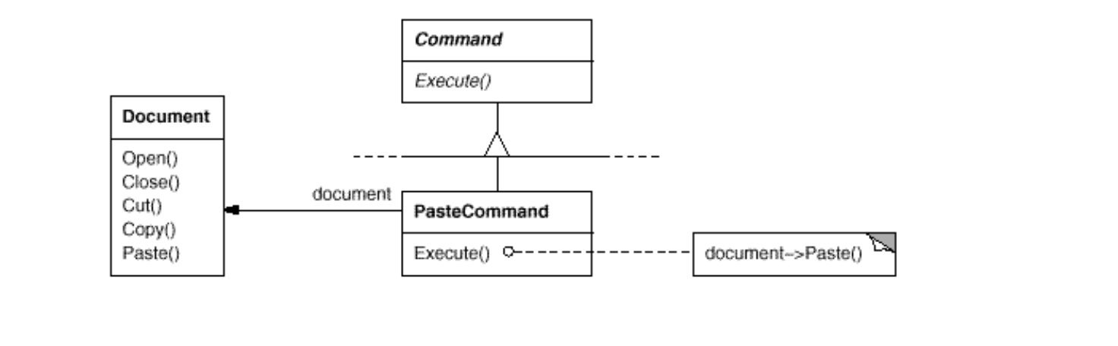
UML Diagram: Paste Command

Slide 8
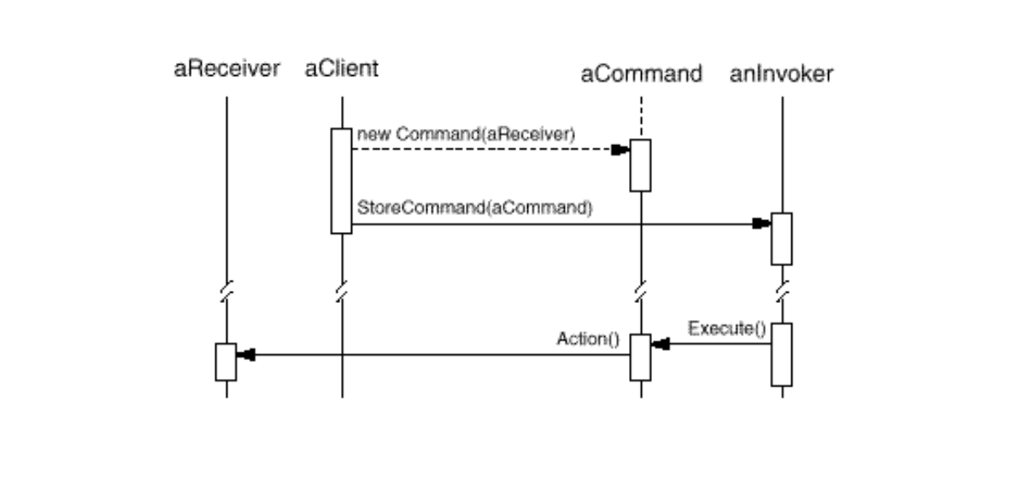
UML Diagram

Slide 9
Implementation
How intelligent should a command be?
At one extreme it merely defines a binding between a receiver and the actions that carryout the request.
At the other extreme it implements everything itself without delegating to a receiver at all.
Supporting undo and redo

Slide 10
Sample Code
The abstract Command class:
class Command {
public:
virtual ~Command();
virtual void Execute() = 0;
protected:
Command();
};

Slide 11
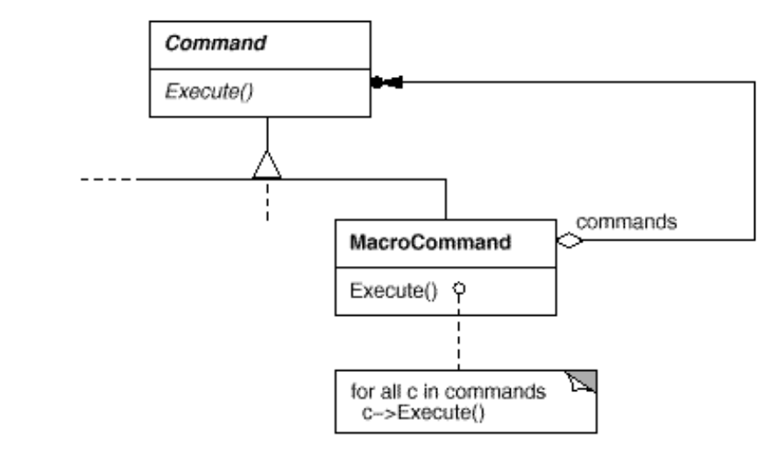
Sequence of Commands
class MacroCommand : public Command

Slide 12
Consequences
Commands are first-class objects. They can be manipulated and extended like any other object.
Follows SOLID Principles
You can assemble commands into a composite command. An example is the MacroCommand class described earlier.

Slide 13
Conclusion
Definition & Usage
UML Diagrams
Implementation & Sample Code
Consequence

Slide 14
Thank You!

